Slide 1

Mitigating the Risk of Artificial Intelligence Generated Spam Emails --Mid Review Presentation--
S17355 – Ravindu Fernando

Slide 2
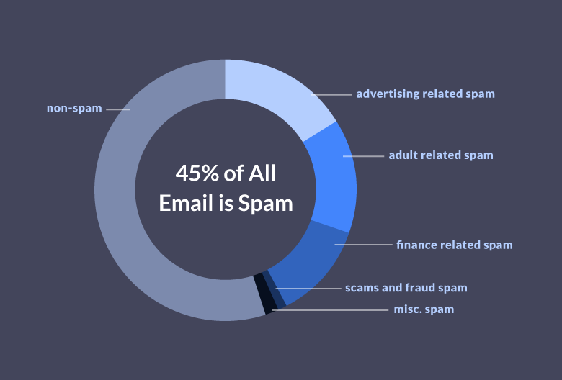
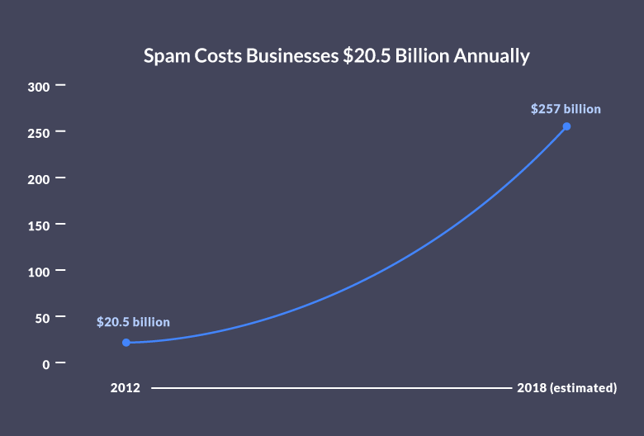
Research Question
Fig 1 : According to a report by the Radicati Group, in 2021, spam accounted for approximately 45.56% of all email traffic globally
Fig 2 : Exponential Growth in cost for Businesses

Slide 3
Aim and Objectives
Create a diverse dataset containing both AI-generated spam emails generated using NLP Techniques along with traditional spam emails.
Design a machine learning model leveraging NLP techniques to effectively classify AI-Generated spam emails.
Assess the performance of the developed model using appropriate evaluation metrics such as precision, recall, accuracy, and F1 score. Compare the model's effectiveness in detecting AI-generated spam emails when mixed with traditional spam emails.

Slide 4

Data collection
Spam and Ham emails were Generated by providing a Email Subject to pre-Trained NLP model (Through Hugging_Face NLP Library) to generate the Email Body.
Pre- Trained NLP Models Used :
pszemraj/opt-350m-email-generation - This model is a fine-tuned version of facebook/opt-350m on the aeslc dataset for six epochs.
postbot/distilgpt2-emailgen-V2 – This model is a fine-tuned version of distilgpt2 on the postbot/multi-email-100k Dataset
And 3 more pre-trained models.

Slide 5
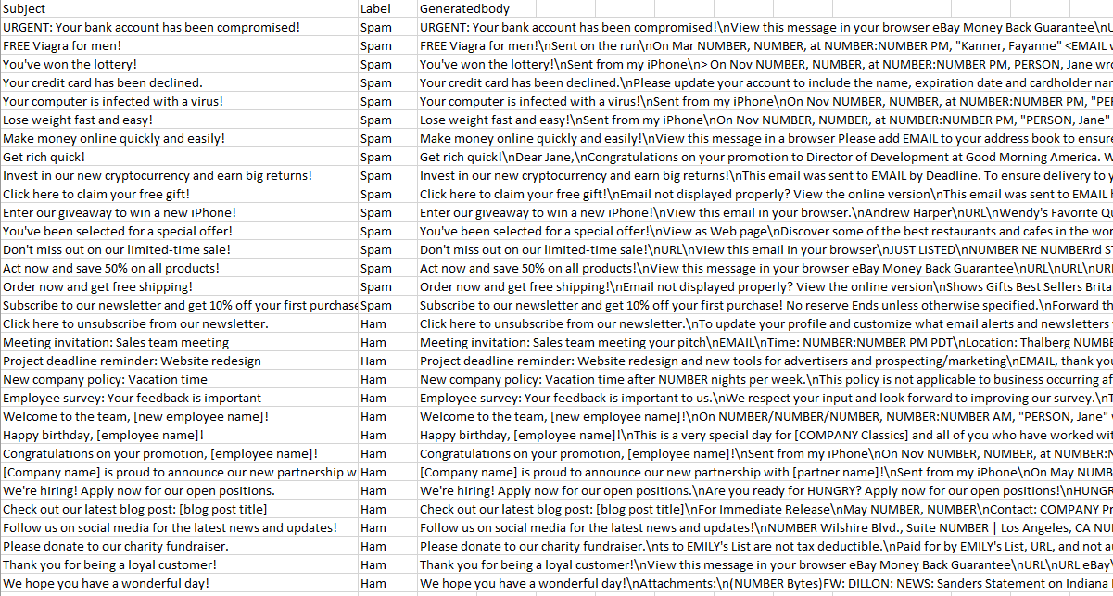
Initiated work/ results
Email Generation
Fig 3 : Generated Spam emails using pre-trained NLP models

Slide 6
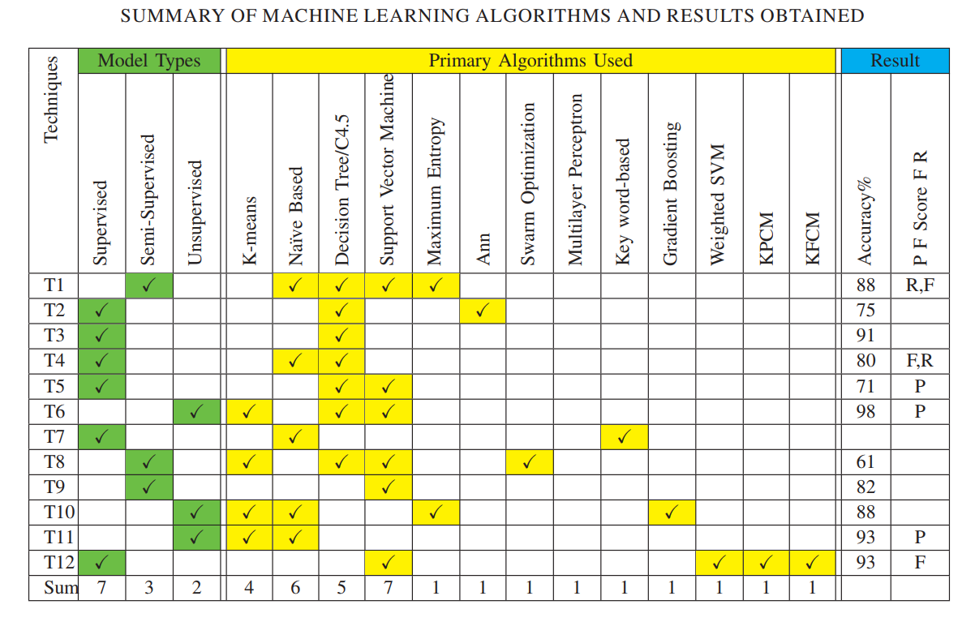
Key Literature
Email Classification
M. RAZA, N. D. Jayasinghe and M. M. A. Muslam, "A Comprehensive Review on Email Spam Classification using Machine Learning Algorithms," 2021 International Conference on Information Networking (ICOIN).
Fine Tuning Model
OPT: Open Pre-trained Transformer Language Models - Meta AI Susan Zhang∗ , Stephen Roller∗ , Naman Goyal∗
Fig 4 : Performance of classical Machine learning models in
Spam Email Classification

Slide 7
Email Classification – Using Pre-Trained Models
NLP Classification Models Used :
mariagrandury/roberta-base-finetuned-sms-spam-detection ➔ Gave Good Results.
SetFit/distilbert-base-uncased__enron_spam__all-train ➔ Mediocre Results.
mrm8488/bert-tiny-finetuned-enron-spam-detection ➔ Not Satisfactory Results.

Slide 8
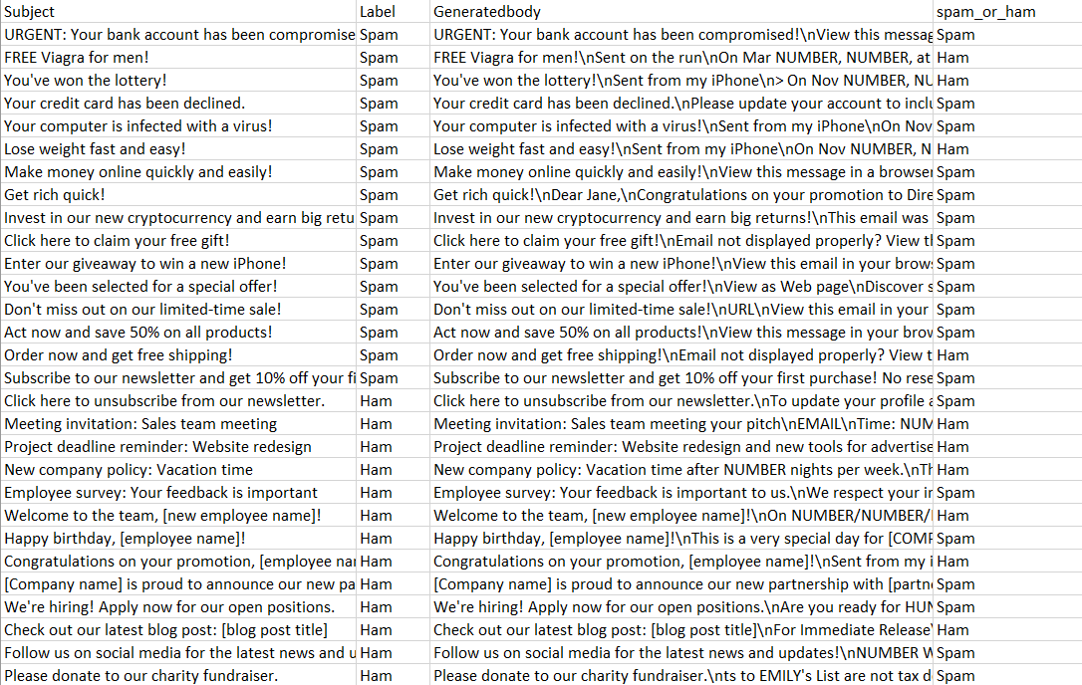
Email Classification
Emails Classified using mariagrandury/roberta-base-finetuned-sms-spam-detection
Fig 5 : Spam Email Classification Using Pre-Trained model

Slide 9
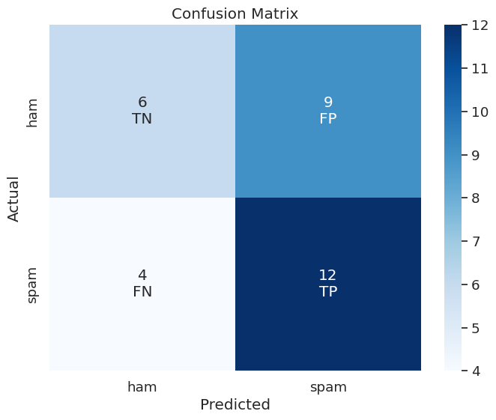
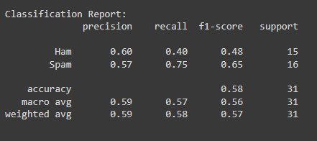
Results and Interpretation
Confusion Matrix + Classification Report for : mariagrandury/roberta-base-finetuned-sms-spam-detection
Fig 7 : Classification Report for the Pre-Trained
model
Fig 6 : Confusion matrix for the Pre-Trained
Classification model

Slide 10
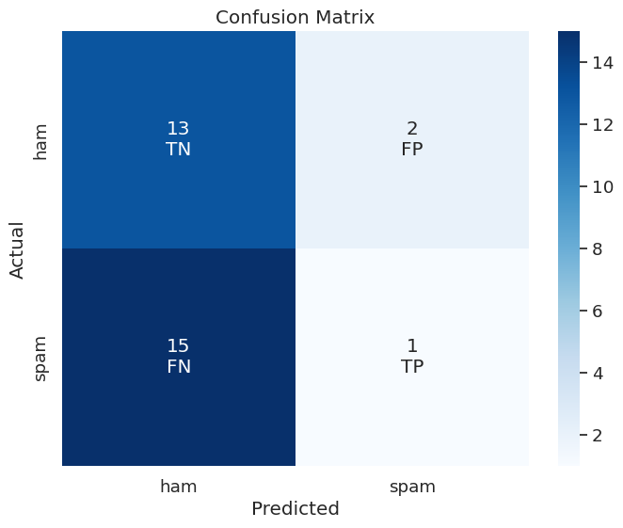
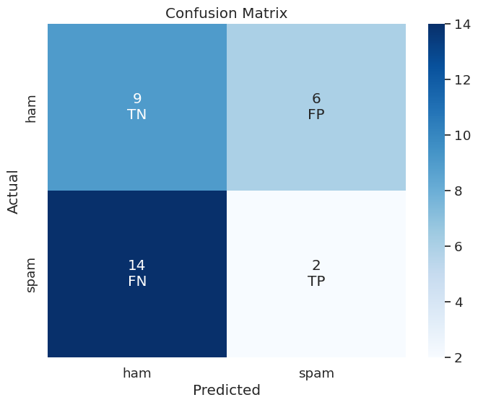
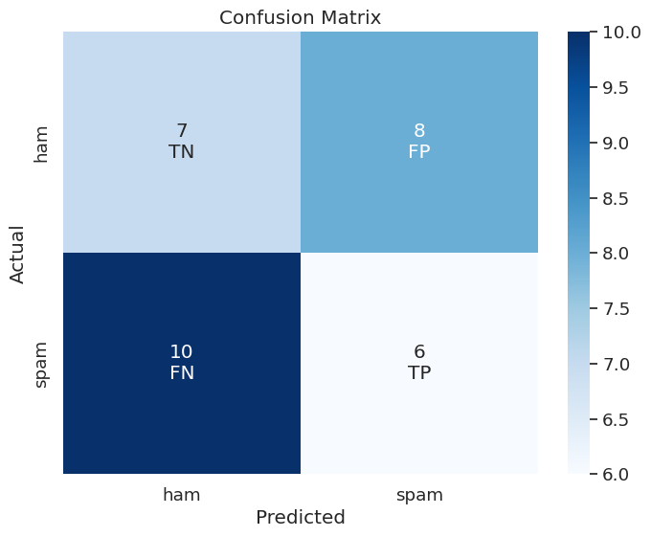
Confusion Matrix for other Classification Models
Fig 8 : mrm8488 _ bert-tiny-finetuned-sms-spam-detection
Fig 9 : mrm8488_bert-tiny-finetuned-enron-spam-detection
Fig 10 : mariagrandury/roberta-base-finetuned-sms-spam-detection

Slide 11
Timeline
Date Action | 1st Jun | 15th Jun | 1st July | 15th July | 1st Aug | 15th Aug | 1st Sept | 15th Sept | 1st Oct | 15th Oct | 1st Nov | 15th Nov | 1st Dec
Topic and Proposal
Literature Survey
Generate the Dataset
Literature Survey on Classification
Test Pretrained Classification Models
Literature Survey on Parameter tuning
Develop Classification Model
Results Discussion and Conclusion
Report Writing and Finalizing
Fig 11 : Timeline Gantt chart

Slide 12
Thank you

